Slide 1
Alchemy Worx Internal CM/Production Process
Updated April 29th 2013– Claire Rollinson

Slide 2
Campaign Manager’s bible
One area that sets Alchemy Worx apart from our competitors is our Campaign Managers (Account Managers). They act as a singular point of contact, ensuring that internal and external clients realize the benefits from our specialist teams, with the lowest possible demands on their time; and are also a specialist team of their own. They have a wealth of knowledge and understanding of every aspect of email marketing, as well as specialist skills in understanding and communicating clients’ needs.
Our Campaign Managers familiarize themselves with every client’s business and campaign objectives, so that they can ensure every aspect of the process develops is in line with these, and every Campaign Manager at Alchemy Worx takes responsibility for campaigns they work on – something we are only able to offer due to the amount of time we invest in making sure we deliver on time, every time and always succeed in getting the job done to the highest possible standard. At least two campaign managers/Campaign Executives are assigned to each client to ensure a consistent level of service.

Slide 3
Production: Campaign Management
Claire Rollinson
Head of Campaign Management
John Cadogan
Senior Campaign Manager
Clare Lopez
Senior Campaign Manager
Lisa Pettit
Senior Campaign Manager
Jenna Patel
Campaign Executive
Charlotte Palmer
Campaign Manager
Chrissie Smith
Campaign Manager
Resham Tulsini
Campaign Manager
Kiran Gill
Campaign Executive
Anna Chan
Campaign Executive
Sarah Jones
Campaign Manager
Danielle Monaco
Campaign Manager
Rashida Thompson
Campaign Executive
James Richardson
Campaign Executive
Charlotte Owen
Campaign Executive
Bianca Khatri
Campaign Executive
Sarah Chaudry
Campaign Executive
Manij Shrestha
Campaign Executive
Jessica Pow
Campaign Executive
Vacant
Campaign executive

Slide 4
Production
Design team: design emails, purchase images, prepare files for build
Html team:
build emails (NL and text), landing pages, forms, prepare for deployment
Deployment team:
set up emails, host images, set up forms, send for render test, Render test, deploy, liaise with ESP’s support team
Data team: manage data, upload data into the ESP platform; run data counts;
Business Intelligence team: create snapshot reports, Subscriber Behaviour Analysis; ROI audits Frequency analysis; Recency analysis; Inactive analysis ; Dashboards; Subject line analysis
Copywriting: Outsource, write, edit and repurpose copy

Slide 5
Documentation
A directory of all the CM documents and process docs which a CM uses and references in doing the job can be found here
CM process and form documentation.xlsx
All of them are referenced and linked to in this document

Slide 6
Outlook Housekeeping
Set up your email signature
Import all internal email addresses into your contacts folder
..\..\..\general\telephones\Contacts_bkUpdated13.02.2013.csv
Set up all your client folders.
Your outlook folder structure should mirror the structure we have for jobs on the server

Slide 7
Setting up your email signature
First thing to do is set this up.
Go to internet explorer
log on to intranet and click on ‘my profile’ (top right of screen) http://intranet.alchemyworx.local/login
Click on ‘My Profile’ and then ‘Download General Signature on (button at bottom of page)
New tab will open containing your signature - Click ‘Save as’ option (may appear as tool bar pop-up at bottom of screen; click on arrow to show Save options).
Save into your pictures as a ‘Firefox Document’ (See Libraries folder).
Go to start menu – click on documents.
Paste the link below into the windows explorer browser and change YOUR_USERNAME to your username… e.g. sjones C:\Documents and Settings\YOUR_USERNAME\Application Data\Microsoft\Signatures
Click and drag your signature from Library images folder into the file above.
Close outlook and reopen.
Go to outlook – Set new signature as default. (Click on new message – go to signatures – click signatures (box will appear) set new message and alchemyworx_signature to alchemy worx signature)

Slide 8
Email maintenance
Guide on email maintenance
Please review this guide on how (d191) on general email maintenance
guide_on_email maintenance.docx
Backing up your email
Backing up e-mail is useful in-case there are problem with your e-mail storage (it gets corrupted or becomes inaccessible) or there is problems with your machine and you are no longer able to access your email. Please try and back-up e-mail at least once a month.
Please review this guide on how (d120)
guide_to_back_up_email.docx

Slide 9
Timesheets
You need to complete timesheets for each day on Synergist
Your login details will be the same ones you log into your computer on
In increments of 15 mins (0.25) you will need to add time spent against each project/client.
Please see Synergist process guide for information regarding using Synergist and completing timesheets cm_worflow_synergist_draftv8.pptx

Slide 10
CM Process Overview

Slide 11
Copy/
Design
Creative Services
Client’s
brief
Consulting
team
Client’s
approval
CM to:
- Receive internal client brief
Acknowledge email
Confirm job/costs & timelines with production
Question logic and make recommendations
Prepare brief and collect assets for production
Create a project number and folder
HTML
Client’s
approval
Data
Data team
Email
Set
Up
Deployment team
Client’s
approval
Client’s
approval
Business Intel team
Report
DEPLOYMENT

Slide 12
AW services
A full list of all services we offer can be found here
client_services.pdf
If a client enquires about an email service you do not see on this list please contact your consultant or speak to Claire R

Slide 13
New Clients
If you are given a new client to look after please ensure you complete the following:
Complete and action all points in the new client induction spreadsheet (document no 101) for the 1st production job
Ensure you have a full induction/handover meeting with all production team leaders so they can input into production processes/ and are familiar with requirements
Ensure you inform Georgia of all billing arrangements
Put together a full production process documentation, including CRF’s and briefing forms
Complete and send job confirmation documents for all new projects required

Slide 14
Start of a campaign
On receipt of brief (d103) and assets provide a quote from Synergist detailing breakdown of costs and milestones for project completion should be sent and approved by the client
For larger/complex projects a Statement Of Work document should be completed
Ask for PO. We should ideally have PO on acceptance of work
Meet with relevant teams to discuss brief and get timings, ensuring we have all relevant assets to start work. Eg if a new design and copy job, please meet with design and copy team before briefing job into production and agree timelines
If we are receiving PSD’s to be built please brief them in to be ‘asset checked’ to the HTML team before we start to build
Timelines for the campaign should then be put together and sent to the client
Add project to the client WIP and monitor all timelines to ensure we hit all project milestones

Slide 15
New Campaign – how to create a new project no?
Always create a project before you brief the production team, using Synergist
For the detailed process click here
Create a project for all type of jobs: mailings, design, builds, reporting jobs
Create a project folder on the server within the client folder with the following folders: assets/design/HTML/copy/data/reporting/QA
Inform all heads of production of client requirements
Steps:
Create a new project on Synergist
Create a folder on the server in 2013, and give the same project number. Format should ALWAYS be (in lower case): clientsabbreviation_pxxx_projectdescription_uniqueidentifier
Type of project: Always refer to this list: \\192.168.1.4\alchemy\2010\clients_abbreviation.xls

Slide 16
Consulting
It is the CM’s responsibility to keep the assigned consultant up to date with all developments and opportunities for a client
All reports sent to the consultant first for checking before they are sent to the client
Consultants to attend all client meetings, unless agreed with them they are not required
CM to maintain a client WIP, with details on all campaigns and ‘consulting’ type tasks included.
New clients
We need to complete onboarding checklist for all new clients

Slide 17
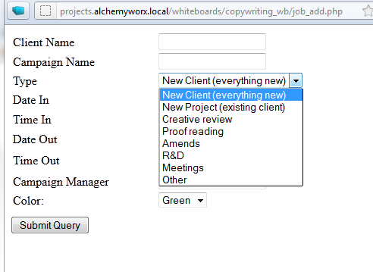
Copywriting
Copywriting
Please click here for explanation of all whiteboard tasks (p102)
Client’s
approval
Design
Client’s
approval
Email
Set up
Client’s
approval
DEPLOYMENT

Slide 18
Copywriting
Copywriting
CM needs to complete copywriting brief (d108) and send to copy editor Dan
CM to copywriter
Please add job to the copywriter whiteboard http://projects.alchemyworx.local/whiteboards/whiteboards/index.htm
Create a _copy_to_do folder in the client folder and a ‘done’ folder
Create a ‘copy’ folder in the project folder and an ‘archive’ folder. ( just like we do for design and HTML)
Complete copy brief or if amends ‘copy to do doc’ and place in the copy to do folder.
Please give as much information ( past mailings, brand guidelines, tone of voice, objectives, audience) as possible on brief.
If you require subject lines for the mailing please indicate this when you brief in the copy
With the brief create a ‘template’ for all client with all the information included and then just ‘populate’ the brief with additional/amended project info. I would also do this for design. ( Then you are not having to complete all the mandatory info everytime!)
Client’s
approval
Design
Client’s
approval
Email
Set up
Client’s
approval
DEPLOYMENT

Slide 19
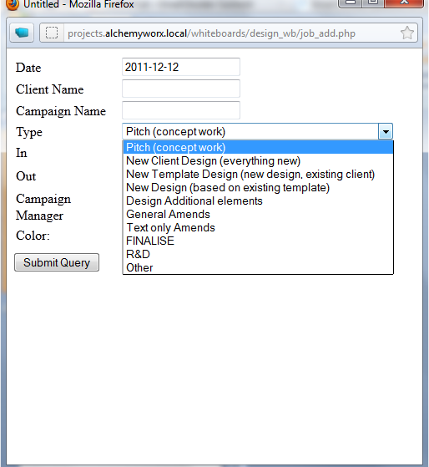
Design
Design
Detailed Creative services process (p103)
Explanation of design whiteboard tasks here (p104)
Campaign Mailing brief to brief new designs here (d108)
Client’s
approval
HTML
Client’s
approval
Email
set up
Client’s
approval
Deployment

Slide 20
Design
Design
CM needs to complete campaign mailing brief compiling following assets to brief the design team: Client brief + brand guidelines + image library if existing + Ideally, we’ll need copy at this stage
All new design jobs start with a kick off meeting with design team and consultant
CM to Design:
CM would send design in a jpg format, and ask for amends. Designers to implement amends on the psd file, and send a revised jpg file to the CM/client for review and approval. When amends are briefed to design, please confirm which version of the design needs amending and do so by creating a ‘design to do’ document
Location: at root folder of each clients’ folder. Not specific to a project
Brief: confirm project number, and work to be done.
IMPORTANT: When a design is approved by a client, please brief on whiteboard to “finalise.” This has to be completed before moving onto HTML build.
Design finalising:
The design team will then prepare the files for coding, and place the final psd into the final folder. The design team is also responsible for purchasing the images from our AW library on istock (except if specified otherwise by client) at this stage.
Please ensure the client has signed off on all images we need to buy – if they amend after this stage extra costs may be applicable
Allow 30mn to 1hr for this step – and this needs to appear on the design board.
Designers need to confirm to the CM that the project is ready to be built, and would then send a path to the psd file.
CM to HTML:
Brief the build onto the html team only when the design team has confirmed that the psd is ready for the build and ALL QA finished. (Details of QA process here)
Note: If client only wants a design, as they’ll do the build, we’ll then send them the psd files and purchase the images from istockPhoto.
Client’s
approval
HTML
Client’s
approval
Email
set up
Client’s
approval
Deployment

Slide 21
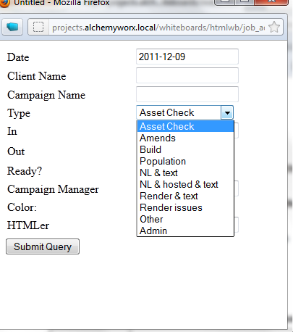
Design
Html process
Details of how PSD should be built in order for HTML to code most effectively (d109)
HTML ‘internal’ briefing document (d116)
Explanation of ‘HTML’ whiteboard tasks (p105)
Detailed process - \\192.168.1.4\alchemy\production\html\2011\process_docs (p106)
Client’s
approval
HTML
Client’s
approval
Email
Set up
Client’s
approval
DEPLOYMENT

Slide 22
Design
Html build
CM to HTML:
If we receive PSD from client or third-party agency brief in an asset check before we start work.
If assets fail the check we will need to go back to the client to advise them on what needs to be fixed to progress the job, or if we can fix it advise that this is the approach we will take – chat to Claire or Lisa if you have to go back to the client re fixes as we might need to consider costs?
HTML will provide feedback on why assets have failed, so that you can provide feedback to your client
Please brief in this PSD check prior to putting the build task on the Whiteboard
If we designed the PSD:
CM to brief the html by placing a brief document into the html_to_do folder and adding the job to the HTML whiteboard with the date it is required by ( once job is complete please move the HTML to do document to the ‘done’ folder’)
Location: at root folder of each clients’ folder. Not specific to a project
Brief: confirm project number, php link if you already have one, and work to be done.
Client’s
approval
HTML
Client’s
approval
Email
Set up
Client’s
approval
DEPLOYMENT

Slide 23
Design
HTML continued…
HTML to CM:
-Html team to code email into html by creating the index file. They’ll create an index file (format: .htm or .html).
-Html team to provide a php link to the cm. CM to send the index preview link to the client for them to review the email (links, rendering, content, etc.)
-Html team will always implement the amends on the index file and reupload using the same path (ie. Preview/php links remain the same).
-As amends are briefed in always create a new HTML to document naming the document amends 1/amends 2/amends 3 as appropriate
Note: Index file = Images hosted on AW server – just to be shown to the client. This is NOT an email at this stage but an online version of the email.
If no deployment by AW: the CM sends html files to clients
Html team to create a ‘render.htm’ version of the email to be able to test it. Brief this into html accordingly.
Brief HTML to create text version asking them to QA the text version. This is only QA’d on request.
Brief deployment team to send ‘render’ file for testing, and brief testing team to test.
When QA completed, send files to the client (Index.htm file + images folder).
If AW hosts images, send the render.htm file but rename it to newsletter.htm first.
Note: Render test = file created for testing purposes only, where images are hosted on AW temporarily. This is NOT the email to be broadcasted.
Client’s
approval
HTML
Client’s
approval
Email
Set up
Client’s
approval
DEPLOYMENT

Slide 24
Design
Creation of the email and campaign set up
File preparation: HTML team to create the EMAIL
When preview link signed off, brief html team to prepare the newsletter and text versions of the email (index) and to provide to CM through php link.
They will add the full paths to the images (host), add footer and hosted version & white list copy, add needed ESP codes (unsub, personalisation, etc.) which need to be briefed by the CM.
Client’s
approval
HTML
Client’s
approval
Email
set up
Client’s
approval
DEPLOYMENT

Slide 25
Design
Landing page requests – whether hosted in ESP or developed by AW
Any landing page request should be treated as a project not BAU. Brief, project scoping (including resources, time/cost, approach risks, questions), journey/pages to be mapped out, testing approach confirmed, client sign off on approach.
Kick off meeting to always take place for any project. The following to be in a kick off/briefing meeting- EDS, HTML, PHP, CM & Design (if required).
Project must be scoped in detail with journey/pages to be mapped out, including page functionality, breaking down any client/platform terminology, set up approach, testing approach confirmed. Project will complete documentation with input from Production depts.
CM to review to confirm meets client requirements. All signed off by internal teams (CM & Project) & client before work starts.
PHP Developers to provide advice on approach, also quality assurance set up checks to be carried out by PHP Developers. PHP Developers will be looped in to project by Robin/Omarr at project scoping phase.
HTML (including PHP) & EDS to work on validation/set up together to trouble shoot any issues.
Client’s
approval
HTML
Client’s
approval
Email
set up
Client’s
approval
DEPLOYMENT

Slide 26
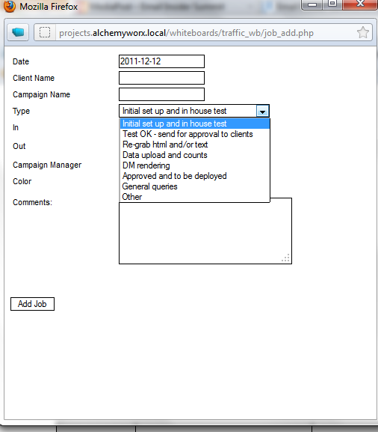
Design
Email set up in the ESP/deployment
CM - deployment: For full process please see here for details, (this includes process for technical projects) (p107)
Explanation of deployment whiteboard tasks here (p108)
To view flowchart on CM/Deployment process click here (p109)
-CM to brief deployment using whiteboard + CRF ( to do cover sheet) (d110)
Client’s
approval
HTML
Client’s
approval
Email
set up
Client’s
approval
DEPLOYMENT

Slide 27
Design
Set up and QA testing
Details of process (internal doc) here (p110)
Client facing document of process here (d111)
Client Specific Testing spreadsheet ( details of what we test on specific clients)
Deployment team to set up email (html and text) and/or forms on the client’s esp, as per the crf provided (initial set up)
They then send a set of in house tests for the CM to check the email, and testers to test rendering and links.
CM to brief testing job onto the testing board and confirm subject line of the email into the ‘comments’ section.
CM should also highlight on the testing board the job type
a) Full test and mobile ( Full test on email platforms and live mobile test on iphone, ipad and Samsung)
b) Full test (links and render test on email platforms and browsers only)
c) Links only
d) Renders test
e) Test against previous errors ( eg. test HTML fixes on previous render/link issues)
Testing team will email CM the ‘testing report’ also placing it in the QA folder (CM to create QA folder within project folder on server)
Client’s
approval
HTML
Client’s
approval
Email
set up
Client’s
approval
DEPLOYMENT

Slide 28
Design
Deployment and testing QA cont
Testing team have developed a client specific checklist of aspects to test. Please let the testing team know if your client or campaign has specific requirements.
For a new client- QA approach needs to be discussed with QA before client is implemented, so that approach & documentation can be confirmed with QA, Consulting, yourself
If a client requests a mobile version and we don’t currently check mobile- this need to be flagged at briefing stage & in the briefs- making design, HTML, QA aware
- If you require forms testing, please indicate this with the testing team as there is a separate process
When internal deployment QA completed, test emails (or proofs, or approval emails) are sent to the client’s approval list.
Clients to check set up of the email (from address, unsubscribe, tracked links, text version, hosted version, etc.)
CM - clients:
No deployment should happen unless the counts have been seen &/or approved by the client.
Once the client approves test emails, deployment and CM team to run final check together, and to deploy the email to the database and to the client’s seed list.
CM to confirm that email has been deployed, sending the client a screenshot of the email scheduled in the platform
Client’s
approval
HTML
Client’s
approval
Email
set up
Client’s
approval
DEPLOYMENT

Slide 29
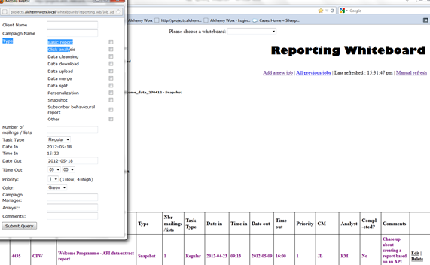
Data work
Click here for description of data whiteboard jobs (p111)
Data work – please click here to view flow chart on CM/data process (p112)

Slide 30
Data work & Post campaign reporting
Data team: Data work
For any new campaigns, non BAU work or ‘strategy tests’ please always have a kick off meeting with data and EDS team to fully discuss requirements and approach
Send an email with a clear brief containing: Project name, Data source name and path on ftp or server, detailed brief of what needs to be done and clear details on the data output you are expecting. Provide path of where the data needs to be saved and what the final list(s) should be named.
Example of data brief to be used can be found here (d112)
Brief data and reporting team using the whiteboard.
When briefing in a list creation job, please populate the column for Number of Mailings/Lists with the amount of lists we will need to upload
Data team will confirm that work is completed as well as, counts, details of steps completed, data upload report
CM to get data counts signed off by the client before any deployment
CM to ensure they are happy the data outputted by data team is as expected
CM to confirm with clients and to brief EDS team and confirm that data is ready.
Costs: always ask the team to confirm if they’ll be any associated costs, and get them approved by the client (if not included in the retainer, project costs already) before the start of the data work

Slide 31
Post campaign reporting
Business Intelligence Team: Snapshot reports and basic metrics report
-When a snapshot is requested, brief business intelligence team using the whiteboard and confirm the details of the report (basic metrics, click analysis, behavioural report, etc.)
When briefing in a snapshot request, please populate the column for Number of Mailings/Lists. with the number of mailings to take into consideration.
Send an email with clear brief, ESP details, list of messages to be taken into account, timelines and request a quote
Send quote to client for approval before starting the work
Once approved, confirm to the reporting team that they can go ahead with the report, according to the agreed timelines.
Please also send the snapshot reports to the design and copy teams

Slide 32
Business Intelligence Team cont
All definitions of reporting metrics can be found under the following link:
W:\alchemy_pre2013\Production\reporting\Client's report\Alchemy Worx Email Marketing Metrics_AK.doc
Generally we have 4 reporting products:
Our reporting portfolio W:\alchemy_pre2013\Production\reporting\Client's report\AW ROI AUDIT.pdf
1./ Basic metrics report
(see example – W:\alchemy_pre2013\Production\reporting\Client's \production\Reporting\Client'sreport\TalkTalk\cumulative_BA_reports\092010_TT_BA.pdf )
2./ Snapshot report
(see example – W:\alchemy_pre2013\Production\reporting\Client's production\Reporting\Client'sreport\TalkTalk\snapshot_reports\17032010_TT_xfactor_Snapshot_report.pdf )
3./ Click analysis
(see example pg: 27-46 – W:\alchemy_pre2013\Production\reporting\Client's production\Reporting\Client's report\National_Express\NE_historical_report_15-11- 2007(FINAL).pdf )
4./ Subscriber behavioural report
(see example – W:\alchemy_pre2013\Production\reporting\Client's \production\Reporting\Client's report\John_Lewis\JL_080110-2_update03022010_vf.pdf )

Slide 33
Quality Assurance/control
QA is everybody’s responsibility. The creative services and deployment team have their own dedicated QA resource. Details of what they check/QA can be found here.
Details of our standard ‘render’ testing process
Creative services
Campaign Management QA check. All CM’s should check all HTML previews, design JPG’s and all testing proofs before sending to the client. Full details of checks can be found here.
CM quality assurance – things to check (d115)

Slide 34
When mistakes happen….
Communication:
Inform Claire R as soon as you are aware an error has occurred.
Recording of errors (internally)
..\..\error_resolution\Error record form.doc (d113)
All mistakes must be documented on the above form
This form is to be completed in the first instance by the production staff member and their manager if the error was made by production. They will then send onto the CM/Claire for our input.
In most cases we will also have a wash up meeting to ensure everyone understands what went wrong and to put the necessary steps in place to ensure mistake does not occur again.
It is important any additional process steps we suggest are implemented asap
Once implemented please update Claire R as I will chase to ensure everything has been actioned

Slide 35
Errors cont:
Root cause analysis form (external communication with client)
Depending on the severity of the error we will complete the below Root cause analysis form to send to the client, which puts all the info on the internal form into a client friendly explanation.
..\..\error_resolution\RCA_AW_template.doc (d114)
Example - ..\..\error_resolution\cpw\RCA_CPW_AW_13052010\RCA_CPW_AW_13052010.pdf

Slide 36
Job allocation: use the whiteboards *
All boards:
http://projects.alchemyworx.local/whiteboards/whiteboards/index.htm

Slide 37
Internal communications
Useful addresses:
eds@alchemyworx.com (Deployment team)
business_intelligence@alchemyworx.com
cm@alchemyworx.com
html@alchemyworx.com
testing@alchemyworx.com.
projects@alchemyworx.com (Any time you have non- business as usual work for deployment/data, please can you email this list with the requirements/project details. Non BAU are any projects such as landing pages, triggers for your clients, anything that is not part of the regular deployment/data jobs.)
consulting@alchemyworx.com
Always put the PROJECT NUMBER in the subject line for all internal communications

Slide 38
Clients Timelines
Please find example of our branded project timelines excel doc to use
client_project_timelines.xlsx
Complete the proposed timelines and then complete actual as you go – so you can check we meeting all milestones

Slide 39
Client meetings at AW
Always check the boardroom is available before booking a client meeting at AW
Ensure you have invited and informed all relevant internal stakeholders – consultant, client relations manager, production staff, Claire R who may be needed
Book meeting on the meeting spreadsheet ..\..\..\general\room_bookings\Meeting_Room_Bookings_2013.xls
Inform Georgia/Charlotte of meeting letting them know of the attendee no’s so they can organise drinks, breakfast or lunch as appropriate
If meeting times/dates change ensure you amend booking slot on calendar and let Georgia know

Slide 40
Invoicing process
Invoicing Process:
Please read the detailed invoice process here

Slide 41
Holidays
Company policy:
The Company’s holiday year runs from1st June to 31st May each year. All holiday must be taken within the year it is accrued and may not be carried into the following year.
No more than 10 days may be taken consecutively.
Holidays request:
Notice:
1 or ½ day holiday – Give a week notice
1 week holiday -- Give 1 month notice
2 weeks holidays – Give 2 months notice
Process:
Send an email to Claire and Georgia and confirm dates requested
Claire to approve holidays on the ‘first ask, first serve’ basis and update holidays spreadsheet
Georgia will then confirm your remaining holidays left

Slide 42
Holidays Cover
Before you go on holidays:
Ensure all CM’s/CE’s on your account are informed at least 1 week advance of your holiday
Please also ensure you inform all your client contacts that you will out of the office and who will be looking after their different projects in your absence
List all projects per clients on a handover document and send to your line managers and your team on your last day at midday and organise a handover meeting
Ensure that the following is included:
PC password
Summary explanation of projects
Link to clients WIP
All client WIPS to be up to date
Try not to organise any conf call/meetings while you are away as the back-up might be too busy to attend
Please set your out of office on before you leave, informing all your clients on your last day in the office
When you get back:
Get an update from all your back ups on all your projects first thing

Slide 43
Send ‘big’ files to clients – Using Sharefile
Ask them if they have their own ftp, and place files there.
If not, please use Sharefile http://www.sharefile.com
ShareFile is a tool for sending, receiving, and organizing your business files online.
It can be used as a password-protected area for sharing information with clients and partners, and it's an easy way to send files that are too large to e-mail.
Details of how to create a login for clients can be found here (d118)
Guide for Adding Clients to Sharefile.docx

Slide 44
Alchemy Worx vision on emails
Email Worx – The Alchemy Worx’ newsletter
Subscribe to email worx here:
http://www.alchemyworx.com/c/newsletter
Read all previous archives here:
http://www.alchemyworx.com/emailworx/

Slide 45
Admin info
Path on server: ..\..\..\admin
You’ll find useful information on:
Alchemy Worx phone list
Expenses form
Sick form
Templates
Booking in conference calls
..\..\..\general\telephones\Conf_Call_Bookings_2013.xls

Slide 46
Alchemy Worx Address
Alchemy Worx Ltd
4th Floor
1 New Oxford Street
London
WC1A 1LW
Nearest tube station: Holborn
Link to Google Map: http://maps.google.co.uk/maps?hl=en&source=hp&q=WC1A%201LW%20&um=1&ie=UTF-8&sa=N&tab=wl
Tel: 0870 908 8803
Fax: 0870 908 8804

Slide 47
Useful info about your phone

